Slide 1

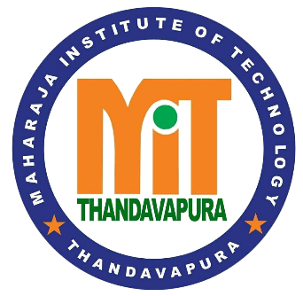

Digitizing Sanskrit Scripts
Maharaja Institute of Technology Thandavapura, Mysore
Department of Computer Science and Engineering
(NBA Accredited for the Academic Duration 2024 – 2027)
Phase – 2 Part – 1
Presenters
Mr.darshan gowda n [4MN21CS014]
Mr.Melvin Dsouza [4MN21CS031]
Ms.SADAF SULTANA [4MN21CS038]
Ms.YAShaswini s [4mn22cs409]
Under the guidance of
Prof.Bharath Bharadwaj B S
Assistant professor
Department of CS&E, MITT

Slide 2
Contents
Introduction
Literature Survey
System Analysis
System Design

Slide 3
Introduction
Objective of project
The main goal of this project is to develop a system that can read printed Sanskrit scripts and convert them into digital text using OCR (Optical Character Recognition). This will make it easier to store, search, and use Sanskrit texts digitally.

Slide 4
Problem Statement
Sanskrit manuscripts are difficult to digitize because of unique challenges like:
Complex characters and ligatures (joined letters)
Use of different scripts (like Devanagari, Grantha, etc.)
Poor quality or faded manuscripts
Limited existing OCR tools for Sanskrit

Slide 5
Scope Of Project
This project focuses on:
Collecting images of Sanskrit texts.
Pre-processing them (cleaning and enhancing images).
Using machine learning and OCR techniques to recognize the text.
Converting the recognized text into editable and searchable digital format.

Slide 6
Motivation
Sanskrit holds a treasure of knowledge, but much of it is not accessible because it's locked in old, physical manuscripts. If we can digitize these texts, we can:
Preserve ancient knowledge.
Make it easier for students and researchers to study.
Prevent the loss of cultural heritage This motivates us to create a tool that can help bring Sanskrit literature into the digital world.

Slide 7
Literature Survey
Sl.no | Published Year | Title of the Paper | Authors | Methodology/ Techniques used | Contribution | Limitations
1 | 2024 | Devanagari Character Recognition: A Comprehensive Literature Review | Sandhya Arora, Latesh Malik, Sonakshi Goyal | The paper reviews different methods for recognizing handwritten Devanagari script, including traditional techniques, machine learning, and deep learning (like CNNs and RNNs). | Deep learning has improved accuracy in recognizing complex characters. Combining different methods gives better results. | Recognition is still hard due to character complexity, writing style variation, and overlapping characters.

Slide 8
Sl.no | Published Year | Title | Authors | Methodology/ Techniques used | Contributuon | Limitation
2 | 2024 | Stroke-Based Data Augmentation for Enhancing OCR of Ancient Handwritten Scripts. | M. P. Ayyoob and P. Muhamed Ilyas | Used stroke-level edits like thickness and direction changes. Keeps character shape intact. | Improved OCR accuracy by 7–10%. Created realistic handwriting variations. | Tested only on Vattezhuthu script. Needs expansion to other scripts.
3 | 2023 | Deep Learning Character Recognition of Handwritten Devanagari Script. | Arpit Sharma and Mithun B N | Surveyed deep learning and ML models. Focused on Devanagari script. Compared CNNs, transfer learning | Deep learning gives better results than traditional ML. | Limited datasets. ML models lack adaptability.

Slide 9
Sl.no | Published Year | Title | Authors | Methodology | Contribution | Limitations
4 | 2022 | A Comparative Study of Handwritten Devanagari Script Character Recognition Techniques | Ranadeep Dey, Pranav Gawade, Ria Sigtia | Compared CNN and HOG for feature extraction. Used SVM, MLP, KNN, and Random Forest classifiers. | CNN with SVM gave the best accuracy. HOG was faster but slightly less accurate. | CNN training takes more time. Devanagari word segmentation is still a major challenge.
5 | 2022 | Digitization of Handwritten Devanagari Text using CNN Transfer Learning. | Sandeep D. Pande, Pramod P. Jadhav, Rahul Joshi | Used CNN with transfer learning on DHCD dataset. | Used dictionary-based conflict resolution for better word prediction. | Depends heavily on the dataset. Needs improvement for characters.

Slide 10
Sl.no | Published Year | Title | Authors | Methodology/ Techniques used | Contribution | Limitations
6 | 2023 | Deep Learning Based Enhanced Handwritten Devanagari Character Recognition using Image Augmentatin | Khushi Sinha, Eshan Marwah, Richa Gupta | Used a Deep CNN with batch normalization, dropout, and ReLU. Applied image augmentation like rotation, zoom, shift, and brightness. | Improved recognition accuracy using augmentation. | Needs powerful GPU for large dataset training.
7 | 2022 | A Systematic Review on OCRs for Indic Documents & Manuscripts | Ch. Venkata Sasi Deepthi, A. Seenu | Reviewed traditional, ML, and deep learning OCR methods. Focus on Indic scripts like Sanskrit, Tamil. | Identified CNN, LSTM, and hybrid methods as promising. | Accuracy drops with low-quality input. Hard to handle handwritten text.

Slide 11
Sl.no | Published Year | Title | Authors | Methodology/ | Contribution | Limitations
8 | 2023 | Real-Time Retrieving Vedic Sanskrit Text into Multi-Lingual Text and Audio. | Anchal Chand, Piyush Agarwal, Sachin Sharma | Used OCR (Tesseract), LSTM, Google Translate & Text-to-Speech. | Converts Sanskrit from Vedic images to editable text, audio, and multiple languages. | Needs stable internet for API functions. Tesseract's performance varies with image quality.
9 | 2023 | Combining Multiple Feature Extraction and Classification Methods to Study handwritten scripts | Shraddha V. Shelke, Dr. S. P. Ugale | Used 4 feature extraction techniques: Resizing, Canny Edge, Hybrid DWT-DCT, HOG. | Highest accuracy using HOG + SVM. Hybrid DWT-DCT also gave strong results. | Struggles with similar-looking characters.

Slide 12
10 | 2022 | Handwritten Vedic Sanskrit Text Recognition Using Deep Learning | Vina M. Lomte, Dharmpal D. Doye | Used CNN with 4-fold architectures. Trained on 70,000 images. Applied preprocessing and classification. | Outperformed Marathi text recognition. No prior Vedic solutions. | Struggles with blurry text. Limited to two scripts. Needs broader script support.
11 |  | Sanskrit Text Recognition using Machine Learning | Pankaj Tukaram Bhise, Vina Lomte, Darshan Derle, Pratik Gitte, Onkar Lonari | Used image preprocessing, K-means clustering for segmentation and CNN for classification | accuracy in recognizing Sanskrit characters using a feedforward neural network. Translation from Sanskrit to English is possible. | Struggles with stylized fonts, older or degraded document clarity, and does not support real-time formatting translation.

Slide 13
Sl.no | Published Year | Title | Authors | Methodology | Contribution | Limitations
12 | 2024 | From Grammar to Algorithms: The Digital Transformation of Sanskrit Studies | Dr. K. Abdul Rasheed | Used Digital Humanities tools like NLP, OCR, semantic tagging, Sandhi reversion algorithms, | Shows how tech helps preserve and study Sanskrit texts. | aced issues like linguistic ambiguities, ethical concerns in digitizing sacred texts.
13 | 2022 | A Survey on Optical Character Recognition for Handwritten Devanagari Script Using Deep Learning | Pragati Hirugade, Nidhi Suryavanshi, Radhika Bhagwat, | Reviewed deep learning and transfer learning methods like CNN, | Provided a comparative study of existing OCR methods, | Requires large datasets, risks overfitting, and struggles with characters that look similar

Slide 14
Sl.no | Published Year | Title | Authors | Methodology/ Techniques used | Contribution | Limitations
14 | 2022 | Optical Character Recognition of Sanskrit Manuscripts using Convolution Neural Networks | Bhavesh Kataria | Used CNN, RNN, LSTM, and BLSTM models; proposed a layered OCR system and a transcription layer. | built a robust OCR model that works even with distorted inputs. | model still dependent on real data and may not handle all complex script.
15 | 2023 | Evaluation of Deep Learning CNN Model for Recognition of Devanagari Digit | Kavita Bhosle | Used deep learning models: CNN, feed-forward neural network, and Random Forest. | It worked well even with noisy or unstructured image data. | Model may still require large data and tuning for best results.

Slide 15
Sl.no | Published Year | Title | Authors | Methodology/ Techniques used | Contribution | Limitations
16 | 2022 | A Benchmark and Dataset for Post-OCR Text Correction in Sanskrit | Ayush Maheshwari, Nikhil Singh | used deep learning models like ByT5, for correcting OCR errors. | ByT5-SLP1 model reduced word error rate. | Models sometimes predict invalid Sanskrit words; no morphological awareness;
17 | 2024 | Advancements in Handwritten Devanagari Character Recognition. | Chetan Sharma, Shamneesh Sharma | Used a dataset of 92,000 images and applied transfer learning with the VGG16 CNN model | showed that VGG16 works well with limited, well-prepared data. | Performance may reduce with very complex handwriting;.

Slide 16
Sl.no | Published Year | Title | Authors | Methodology/ Techniques used | Contribution | Limitations
18 | 2025 | AI-Based OCR for Ancient Indian Texts |  | Regression, ANOVA, surveys on 100 people. | Algorithm boosts accuracy (β=0.615). Public confusion noted. | Small, middle-aged sample.
19 |  | Digitization of handwritten Devanagari text using CNN transfer learning | S.D. Pande, P.P. Jadhav, R. Joshi | CNN model with 12 layers, pre-processing, segmentation, and word reconstruction. | Improved accuracy in recognizing Devanagari handwritten text. | Depends heavily on datasets; struggles with rare consonant clusters. |

Slide 17
Sl.no | Published Year | Title | Authors | Methodology/ Techniques used | Contribution | Limitations
20 | 2022 | Proposed Design to Recognize Ancient Sanskrit Manuscripts with Translation Using Machine Learning | Kulkarni, Pandit, Kharate, Tikkal, Chaware | CNN for OCR, preprocessing, segmentation, Googletrans for translation. | Accurate Sanskrit recognition and English translation, boosts access to ancient texts. | Works best on clear texts, struggles with degraded ones, needs web app.

Slide 18
Functional requirements
Allow image upload of Sanskrit handwritten scripts .
Preprocess images to enhance quality, remove noise, and correct skew.
Recognize Sanskrit handwriting and convert it to machine-readable .
Translate Sanskrit text into other languages

Slide 19
Non Functional requirements
Performance: The system should work quickly, giving results in just a few seconds.
Accuracy: The system should correctly recognize most of the handwriting and give meaningful translations.
Usability: Provide a simple, user-friendly interface for all user levels.
Compatibility: Support common image formats and run on browsers.
Maintainability: The system should be easy to update, fix, and improve over time.

Slide 20
Feasibility Study
1. Technical Feasibility
The tools used , like OCR (to read handwriting), image processing, and translation tools.
software like Tesseract OCR and OpenCV can help with text recognition and cleaning the images.
For better accuracy is needed, we can train our models using tools like TensorFlow or PyTorch.
2. Economic Feasibility
The cost to build this system is not too high, especially when using free tools.
This system will save time and money by doing the work that would take lot of effort if done by hand

Slide 21
Feasibility Study
3. Operational Feasibility
The system will be easy to use.
Anyone like students, teachers, or researchers can use it by just uploading an image and getting the text and translation.
It will also be easy to fix or update when needed.

Slide 22
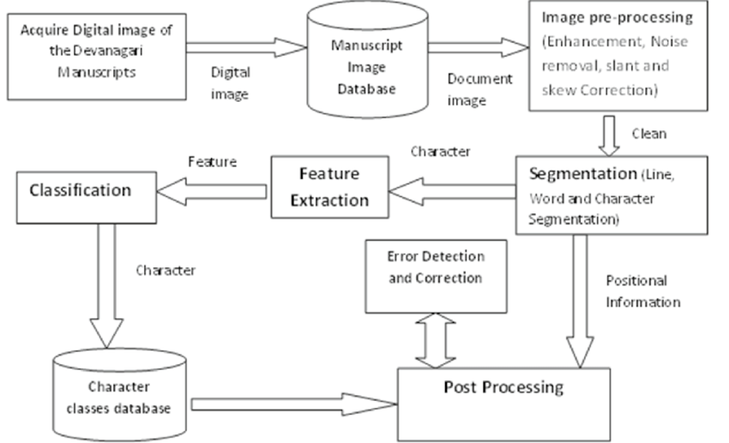
System Architecture overview

Slide 23
Use Case
Sanskrit digitization system
Upload Sanskrit image
Perform OCR
Clean extracted text
User
Translate to English
Display Output

Slide 24
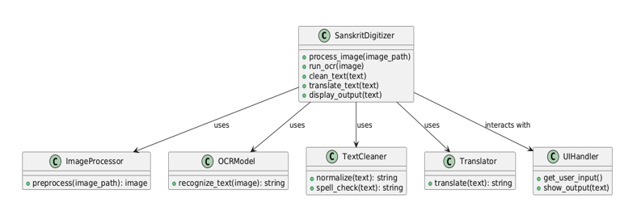
Class Diagram

Slide 25
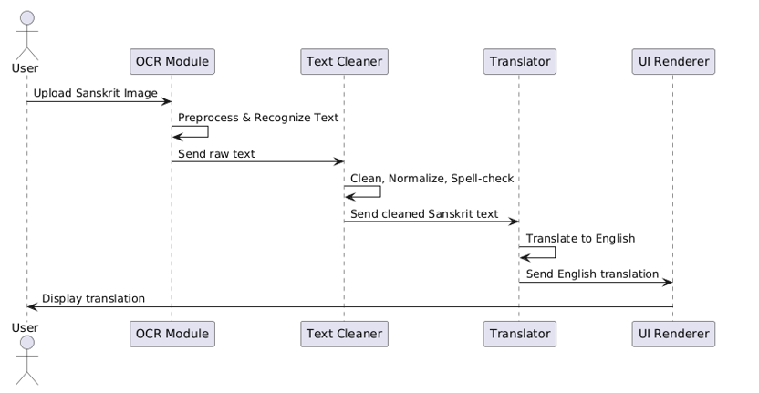
Sequence Diagram

Slide 26
Activity Diagram
User upload the Sanskrit image
Process the image
Run OCR on image
Extract raw Sanskrit text
Clean and normalize text
Check spelling and grammar
Translate to English using Translator API
Display translate text to user

Slide 27
High Level Design
Image Acquisition
Input image
Preprocessing
Preprocessed Image
Text Detection (Deep Learning)
Detected Text Regions
Character Segmentation
Segmented Characters
OCR with Deep Learning
Recognized Characters
Post-Processing
Final output
Output (Text)

Slide 28
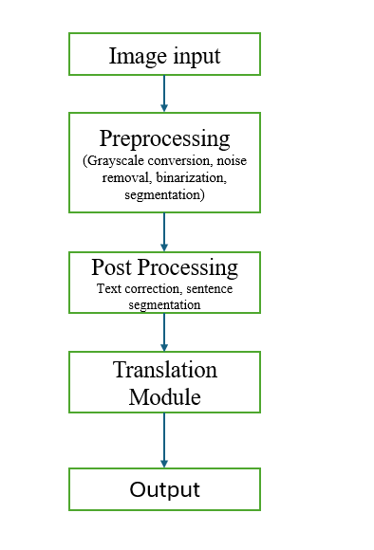
Low Level Design

Slide 29
Requirement Traceability Matrix (RTM)
Requirement ID | Requirement Description | Test Case ID | Test Case Description | Status | Remarks
REQ-001 | Image Preprocessing: Image needs to be resized, normalized, and preprocessed for OCR. | TC-001 | Verify that the input image is resized to standard dimensions. | In Progress | Ensure the image is not distorted after resizing.
REQ-002 | Noise Removal: Remove noise from the image to improve recognition accuracy. | TC-002 | Check that noise removal is effective, with no loss of character detail. | Pending | Test with noisy and clean images.
REQ-003 | Binarization: Convert the image to a binary format to enhance OCR performance. | TC-003 | Verify that the image is successfully binarized. | Pending | Ensure the binarization improves contrast.
REQ-004 | Character Segmentation: Ensure that characters in the Sanskrit script are correctly segmented. | TC-004 | Verify the segmentation of individual characters. | Pending | Check for both horizontal and vertical scripts.

Slide 30
Requirement ID | Requirement Description | Test Case ID | Test Case Description | Status | Remarks
REQ-005 | Feature Extraction: Extract relevant features for recognizing Sanskrit script. | TC-005 | Test that features are accurately extracted from segmented characters. | Pending | Evaluate features’ contribution to OCR.
REQ-006 | Deep Learning Model (CNN + RNN): A deep learning model to recognize characters. | TC-006 | Validate the model's accuracy in recognizing individual characters. | Pending | Model should handle different styles of Sanskrit.
REQ-007 | OCR Engine: Integration of OCR (e.g., Tesseract) or a custom model for script recognition. | TC-007 | Test OCR engine performance with Sanskrit script images. | Pending | Compare results with ground truth data.
REQ-008 | Text Cleanup: Postprocess recognized text by removing any noise or incorrect characters. | TC-008 | Ensure that the cleaned-up text is accurate and formatted. | Pending | Remove noise like random characters or artifacts.
REQ-009 | Text Formatting: Ensure the output text is structured properly. | TC-009 | Verify the text output is formatted according to spacing and structure. | Pending | Check for formatting issues like spacing.

Slide 31
Requirement ID | Requirement Description | Test Case ID | Test Case Description | Status | Remarks
REQ-010 | Output Generation: Generate the recognized Sanskrit text in a usable format (e.g., text, structured data). | TC-010 | Check that the output is successfully saved or displayed in the correct format. | Pending | Ensure output format compatibility (e.g., .txt, .csv).
REQ-011 | Performance & Accuracy: Ensure the system recognizes Sanskrit script with high accuracy. | TC-011 | Evaluate the system's accuracy with different Sanskrit script images. | Pending | Perform multiple tests for various datasets.
REQ-012 | Scalability: The system should handle large volumes of Sanskrit script images. | TC-012 | Test system's scalability with a large dataset of Sanskrit images. | Pending | Measure time taken for processing large batches.
REQ-013 | User Interface: Provide a user-friendly interface for users to upload Sanskrit script images. | TC-013 | Ensure that the upload interface is intuitive and easy to use. | Pending | Test on various devices and browsers.
REQ-014 | Error Handling: Handle errors in preprocessing, recognition, and output generation. | TC-014 | Test error handling for invalid images or failed OCR processes. | Pending | Ensure error messages are clear and informative.

Slide 32
Datasets
Source
Kaggle offers key datasets for script recognition and translation.
Devanagari dataset has 90,000 handwritten character images.
Community support boosts development with shared code and ideas.

Slide 33
Preprocessing Steps
The image is first converted to grayscale, and noise is removed
using filters to enhance text clarity.
Skew correction is then applied to align the text properly for better OCR results.
Text regions are detected, resized, and normalized to ensure
consistent input quality for the OCR module.

Slide 34
Samples
Character | Datasets
46 | 92000(46*2000) each

Slide 35
Implementation
Technology stack
Python – Core programming language for building the pipeline.
OpenCV – Used for image preprocessing tasks like noise removal,
skew correction, and text region detection.
Custom OCR – For recognizing Sanskrit text from images.
Translation Models – For accurate translation into English and Kannada.

Slide 36
Development Environment
Operating System: Windows 10 / Ubuntu 20.04 ( on user preference)
IDE: VS Code / Jupyter Notebook – for writing and testing code interactively
Python Version: Python 3.8 or above – main programming language for all
modules
Libraries & Frameworks:
OpenCV for image processing
TensorFlow/Keras or Tesseract for OCR
Transformers (Hugging Face) for translation models

Slide 37
Module-wise implementation with description
Image Preprocessing Module
Prepares the input image for OCR by enhancing text clarity and aligning it properly.
2) Custom OCR Module
Recognizes and extracts text from the preprocessed image.
3) Sentence Reconstruction Module
Fixes word order and syntax errors to ensure correct sentence structure.
4) Semantic Analysis Module
Interprets the meaning of Sanskrit sentences and ensures accurate semantic representation.
5) Translation Module
Provides meaningful translations while preserving contextual integrity.

Slide 38
Testing
Testing Methodology
The testing methodology ensures that software meets its requirements and works without issues
Unit Testing
Test individual components (e.g., OCR, preprocessing, translation) to ensure each works correctly with predefined inputs and expected outputs.
Integration Testing
Test the entire pipeline by feeding an image through all modules to check if they work together as expected.

Slide 39
System Testing
Verify that the entire system functions correctly from image upload to final translation output.
Ensure the system can handle different types of Sanskrit text, including printed, handwritten, noisy, and skewed images.
Validate that the system extracts accurate text, reconstructs sentences properly, and provides correct translations.
User Acceptance Testing (UAT)
Allow end-users to test the system with real-world Sanskrit text and provide feedback on its functionality and usability.

Slide 40
Relevant Test Cases
TEST CASE ID | DESCRIPTION | INPUT | EXPECTED OUTPUT | ACTUAL OUTPUT | STATUS | BUG TRACKING
TC_01_IMG_CLEAN | Preprocess clean image | Clear image of Sanskrit verse | High-contrast binary image | As expected | Pass | -
TC_02_IMG_NOISE | Preprocess noisy/skewed image | Blurred/skewed Sanskrit script image | Denoised, deskewed image | Slight blur | Partial | Enhance preprocess filter
TC_03_OCR_STD | OCR extraction from clean image | Clean image: "विद्या ददाति विनयम्" | Correct text output | Accurate | Pass | -
TC_04_OCR_NOISE | OCR extraction from noisy image | Skewed + shadow image | ~90% accurate characters | 2 misread chars | Fail | Improve char segmentation
TC_05_SENTENCE | Sentence correction post-OCR | Raw OCR: "विद्या ददाति विनयम्" | Correct grammatical sentence | As expected | Pass | -
TC_06_SEM_VALID | Check semantic validity of simple sentence | "बालकः पठति" | Marked valid, subject-verb agree | Validated | Pass | -
TC_07_SEM_ERROR | Detect semantically invalid sentence | "कर्मणि बालकः क्रीडति" | Flag: misuse of case roles | Flagged | Pass | -
TC_08_PRONOUN | Pronoun resolution | "रामः वनं गच्छति। सः सीतां पश्यति।" | Resolve सः as रामः | Accurate | Pass | -
TC_09_TRANSL_EN | Translation to English | "विद्या ददाति विनयम्" | "Knowledge gives humility" | Correct | Pass | -
TC_10_TRANSL_KA | Translation to Kannada | Same input | "ಜ್ಞಾನವು ವಿನಯವನ್ನು ನೀಡುತ್ತದೆ" | Correct | Pass | -

Slide 41
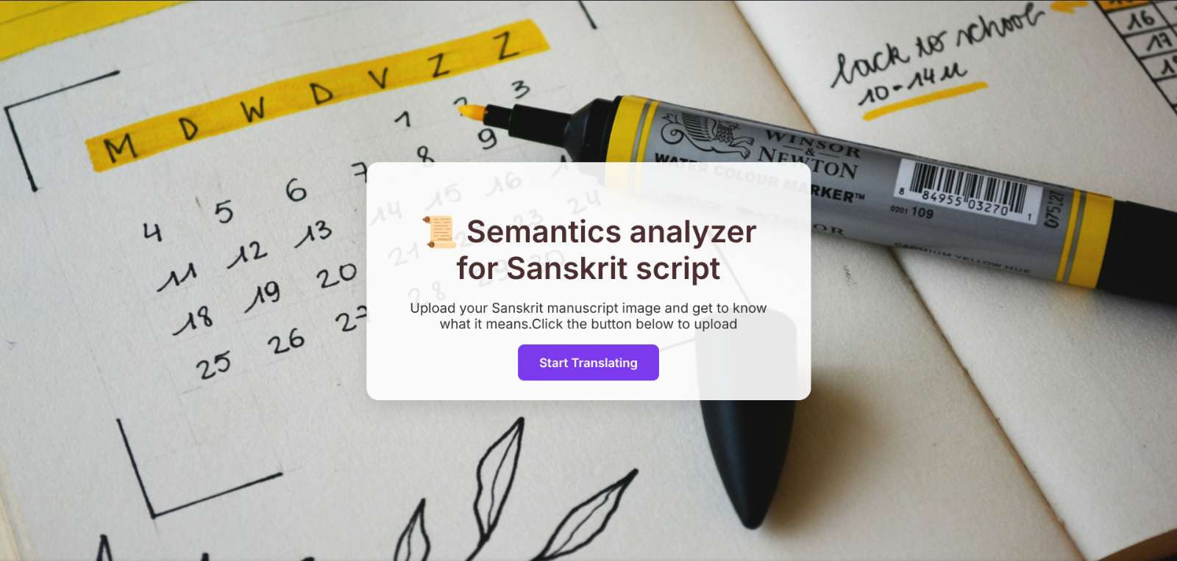
Results and Discussion
Fig : Index Page

Slide 42
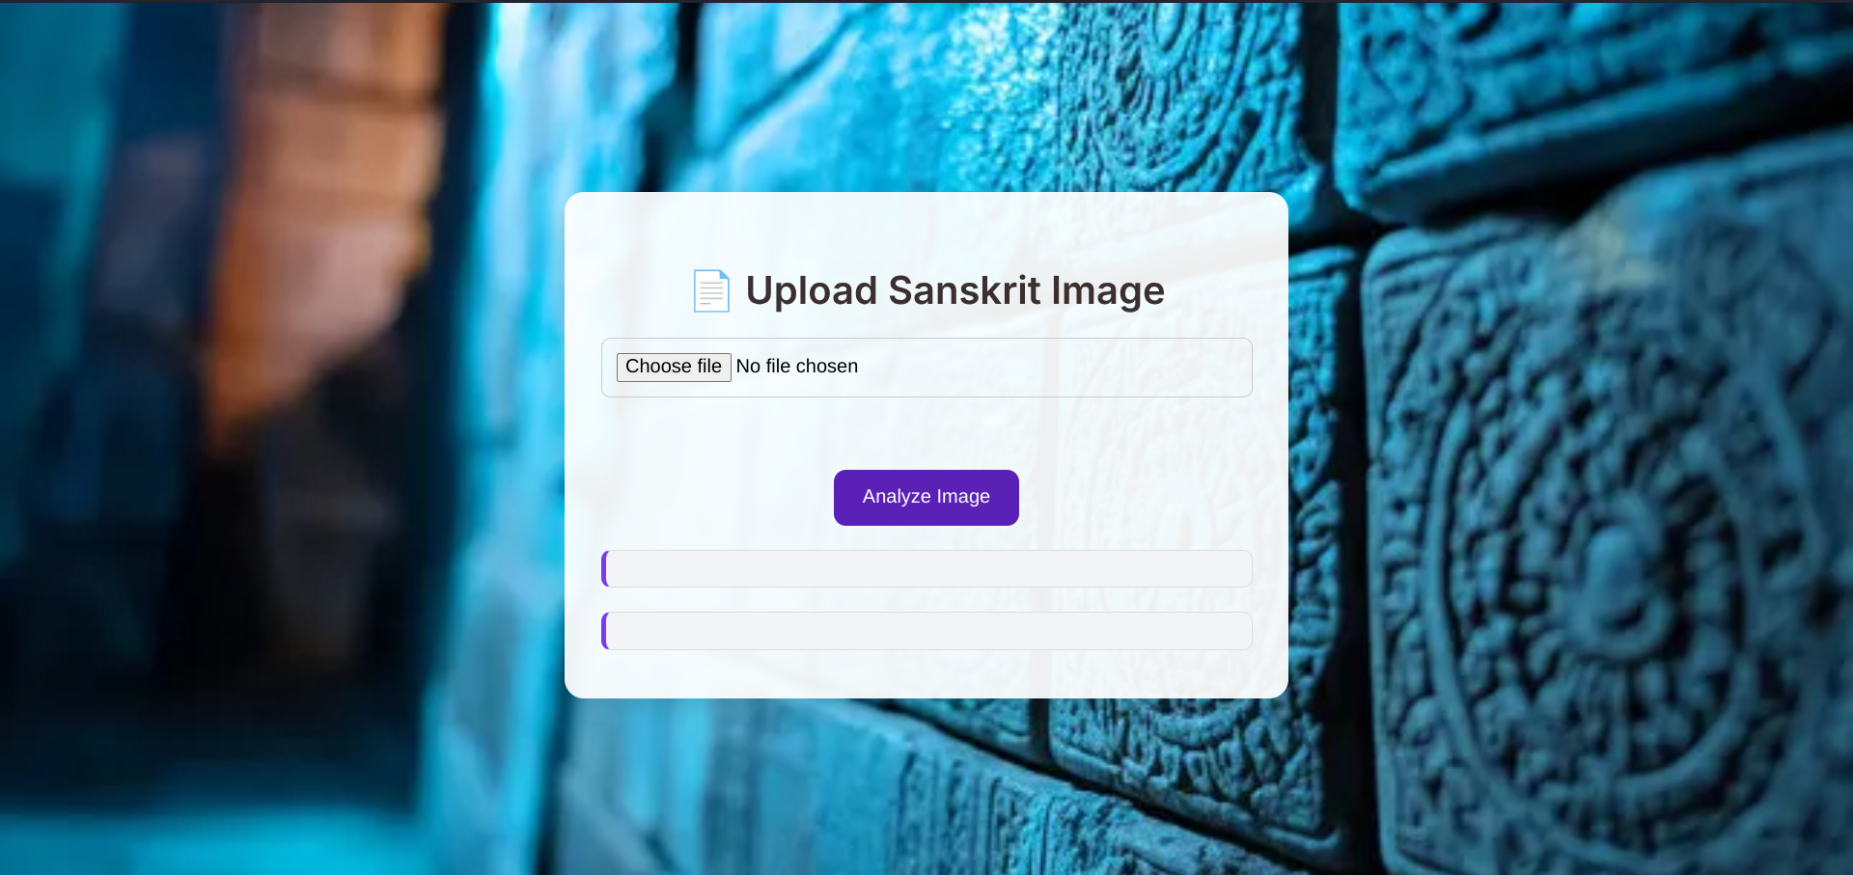
Fig : Uploading an image

Slide 43
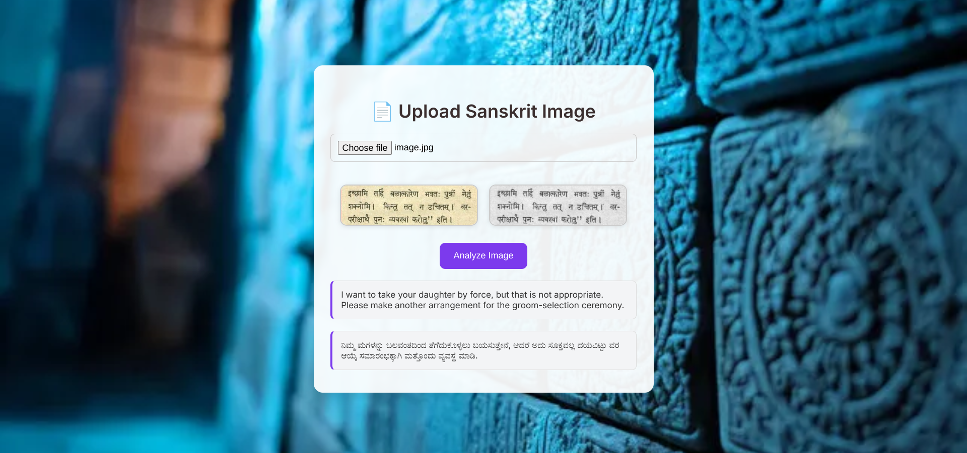
Fig : Result page

Slide 44
Conclusion and Future Enhancement
This project successfully developed a system to extract and translate Sanskrit text from images using custom OCR, sentence correction, and multilingual translation. It showed good accuracy in clean conditions and preserved semantic meaning well.
Future enhancements include improving OCR with larger datasets, adding more Indian languages, using better NLP models, and creating a user-friendly web interface.

Slide 45
THANK YOU

